Slide 1

DATA SCIENCE EL-334
LECTURE # 03
Reading and manipulating csv files
BSIT
by
Safoora Qurban

Slide 2

Reading and manipulating csv files

Slide 3
What are CSV Files?
CSV, Comma Separated Values, is a plain text file format used to store structured tabular data.
In a CSV file, a line represents a row in a table. Each line consists of a comma-separated value, representing a column in a row.
A CSV file is saved with a .csv extension.
Name, Age, Department
Alice,30,HR
Bob,24,IT
Charlie,28,Finance

Slide 4
What are CSV Files Used For?
CSV files are extensively used across various applications and platforms. Some of the advantages of CSV files are:
Data Analysis: CSV files are used to analyze data and to manipulate datasets for analysis.
Spreadsheet Applications: CSV files allow easy data manipulation and sharing using various spreadsheet applications, such as Microsoft Excel and Google Sheets.

Slide 5
What are CSV Files Used For?
Customer Relationship Management (CRM): CSV files are used to manage and analyze data, such as managing contact lists, campaign data, and customer management.
E-commerce and Inventory Management: CSV files help manage product listings and update inventory to allow data to be coordinated in bulk.
Imagine you are a Data Analyst at a startup. You regularly receive data from many sources. To manage the data, you start by storing it in a CSV file and processing it using a programming language such as Python.

Slide 6
Open CSV Files in Python
To work with CSV files in Python, the CSV module part of the standard library (no need to install it) is used.
import csv
A CSV file can be opened using the built-in function open() with the appropriate mode like (‘r’ for reading, ‘w’ for writing, or ‘a’ for appending). It’s better to use the with statement that automatically handles the closing of the file even if any error occurs.

Slide 7
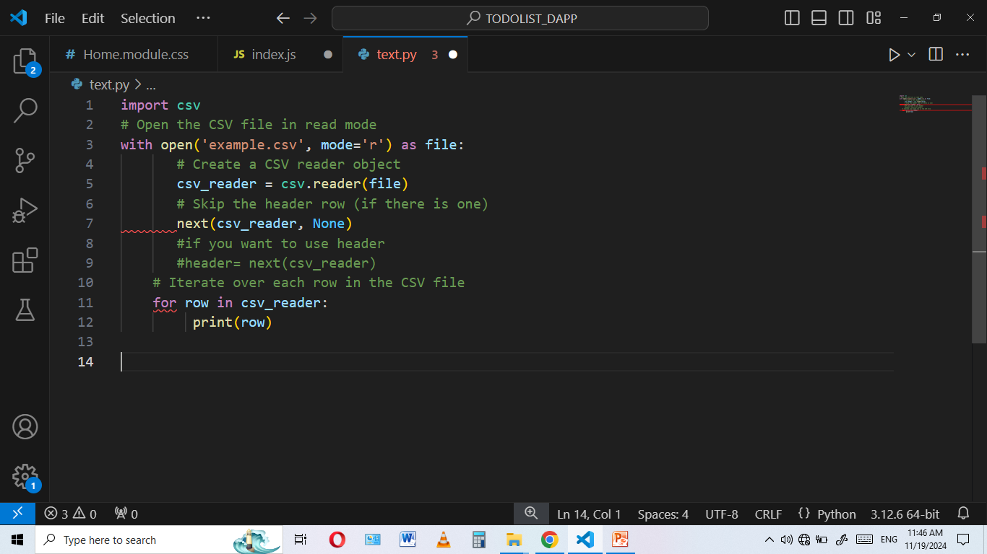
Open CSV Files in Python
In this code, we create a CSV reader object using csv.reader(file), which reads a CSV file and returns each row as a list of strings.
Next, we read the header of the CSV file using the next(csv_reader) function which is used to retrieve the next item from an iterator. A header in a CSV file is the first row that contains the names of the columns, providing a label for each column’s data.
Then, we loop through the remaining rows in the CSV file, printing each row as a list of strings. This approach allows us to easily read and process CSV data in Python.

Slide 8
Writing to a CSV File in Python
To write the data into a CSV file, first open the file in write mode using the with statement and then create a writer object using the csv.writer(file) to allow us to write the data into the file.
Let’s look at an example.
In a CSV file named output.csv, we have the following information:
Name, Age, Department
Alice,30,HR
Bob,24,IT
Charlie,28,Finance

Slide 9
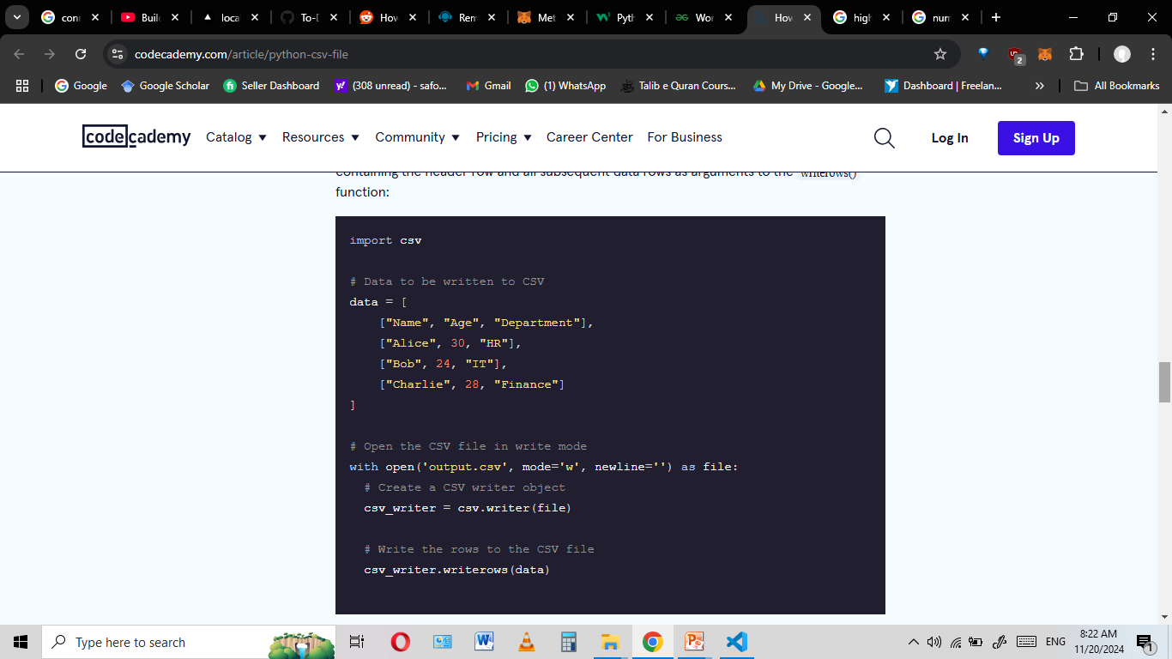
Writing to a CSV File in Python
Following the code snippet opens the output.csv file and defines a list containing all the data that is to be written into the CSV file.
Then, the csv.writer(file) object writes the data into the output.csv file by passing the list containing the header row and all subsequent data rows as arguments to the writerows() function:

Slide 10
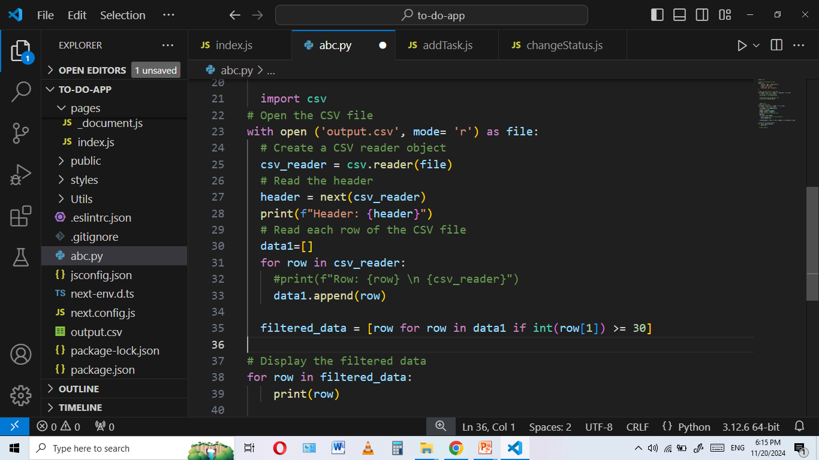
Manipulate and Analyze Data using CSV Files
Data manipulation and analysis are important skills to have for any data analyst or scientist.
Filtering Data
Filtering data involves selecting rows that meet certain criteria. For example, we might want to filter rows where the age of the employees is greater than 25.

Slide 11
Manipulate and Analyze Data using CSV Files (cont.)
Adding a New Column
Adding a new column involves creating additional data based on the existing columns or with new data. For instance, we might want to add a column that calculates the age of each employee next year.
Notes:
This loop iterates over each row in the data list. In each row, it adds a new key-value pair where the key is ‘age_next _year’ and the value is the current age incremented by one. This creates a new column in the dataset.

Slide 12

Numpy module Python

Slide 13
Numpy introduction
Stands for Numerical Python
Is the fundamental package required for high performance computing and data analysis
NumPy is so important for numerical computations in Python is because it is designed for efficiency on large arrays of data.
It provides
ndarray for creating multiple dimensional arrays
Internally stores data in a contiguous block of memory, independent of other built-in Python objects, use much less memory than built-in Python sequences.
Standard math functions for fast operations on entire arrays of data without having to write loops
NumPy Arrays are important because they enable you to express batch operations on data without writing any for loops. We call this vectorization.

Slide 14
NumPy ndarray vs list
One of the key features of NumPy is its N-dimensional array object, or ndarray, which is a fast, flexible container for large datasets in Python.
Whenever you see “array,” “NumPy array,” or “ndarray” in the text, with few exceptions they all refer to the same thing: the ndarray object.
NumPy-based algorithms are generally 10 to 100 times faster (or more) than their pure Python counterparts and use significantly less memory.
import numpy as np
my_arr = np.arange(1000000)
my_list = list(range(1000000))

Slide 15
ndarray
ndarray is used for storage of homogeneous data
i.e., all elements the same type
Every array must have a shape and a dtype
Supports convenient slicing, indexing and efficient vectorized computation
import numpy as np
data1 = [6, 7.5, 8, 0, 1]
arr1 = np.array(data1)
print(arr1)
print(arr1.dtype)
print(arr1.shape)
print(arr1.ndim)

Slide 16
Creating ndarrays
Using list of lists
import numpy as np
data2 = [[1, 2, 3, 4], [5, 6, 7, 8]] #list of lists
arr2 = np.array(data2)
print(arr2.ndim) #2
print(arr2.shape) # (2,4)

Slide 17
Creating ndarrays
array = np.eye(3)
[[1. 0. 0.]
[0. 1. 0.]
[0. 0. 1.]]
array = np.arange(0, 10, 2)
[0, 2, 4, 6, 8]
array = np.random.randint(0, 10, (3,3))
[[6 4 3]
[1 5 6]
[9 8 5]]
array = np.array([[0,1,2],[2,3,4]])
[[0 1 2]
[2 3 4]]
array = np.zeros((2,3))
[[0. 0. 0.]
[0. 0. 0.]]
array = np.ones((2,3))
[[1. 1. 1.]
[1. 1. 1.]]
arange is an array-valued version
of the built-in Python range function

Slide 18
Arithmetic with NumPy Arrays
Any arithmetic operations between equal-size arrays applies the operation element-wise:
arr = np.array([[1., 2., 3.], [4., 5., 6.]])
print(arr)
[[1. 2. 3.]
[4. 5. 6.]]
print(arr * arr)
[[ 1. 4. 9.]
[16. 25. 36.]]
print(arr - arr)
[[0. 0. 0.]
[0. 0. 0.]]

Slide 19
Arithmetic with NumPy Arrays
Arithmetic operations with scalars propagate the scalar argument to each element in the array:
Comparisons between arrays of the same size yield boolean arrays:
arr = np.array([[1., 2., 3.], [4., 5., 6.]])
print(arr)
[[1. 2. 3.]
[4. 5. 6.]]
print(arr **2)
[[ 1. 4. 9.]
[16. 25. 36.]]
arr2 = np.array([[0., 4., 1.], [7., 2., 12.]])
print(arr2)
[[ 0. 4. 1.]
[ 7. 2. 12.]]
print(arr2 > arr)
[[False True False]
[ True False True]]

Slide 20
Indexing and Slicing
One-dimensional arrays are simple; on the surface they act similarly to Python lists:
arr = np.arange(10)
print(arr) # [0 1 2 3 4 5 6 7 8 9]
print(arr[5]) #5
print(arr[5:8]) #[5 6 7]
arr[5:8] = 12
print(arr) #[ 0 1 2 3 4 12 12 12 8 9]

Slide 21
Indexing and Slicing
As you can see, if you assign a scalar value to a slice, as in arr[5:8] = 12, the value is propagated (or broadcasted) to the entire selection.
An important first distinction from Python’s built-in lists is that array slices are views on the original array.
This means that the data is not copied, and any modifications to the view will be reflected in the source array.
arr = np.arange(10)
print(arr) # [0 1 2 3 4 5 6 7 8 9]
arr_slice = arr[5:8]
print(arr_slice) # [5 6 7]
arr_slice[1] = 12345
print(arr) # [ 0 1 2 3 4 5 12345 7 8 9]
arr_slice[:] = 64
print(arr) # [ 0 1 2 3 4 64 64 64 8 9]

Slide 22
Indexing
In a two-dimensional array, the elements at each index are no longer scalars but rather one-dimensional arrays:
Thus, individual elements can be accessed recursively. But that is a bit too much work, so you can pass a comma-separated list of indices to select individual elements.
So these are equivalent:
arr2d = np.array([[1, 2, 3], [4, 5, 6], [7, 8, 9]])
print(arr2d[2]) # [7 8 9]
print(arr2d[0][2]) # 3
print(arr2d[0, 2]) #3

Slide 23
Exercise
Consider the two-dimensional array, arr2d.
Write a code to slice this array to display the last column,
[[3] [6] [9]]
Write a code to slice this array to display the last 2 elements of middle array,
[5 6]
arr2d = np.array([[1, 2, 3], [4, 5, 6], [7, 8, 9]])

